Slide 1
Effect of statins on functional expression of membrane transporters in L6 rat skeletal muscle cells
(Journal of Biomedical and Clinical Sciences)

Slide 2
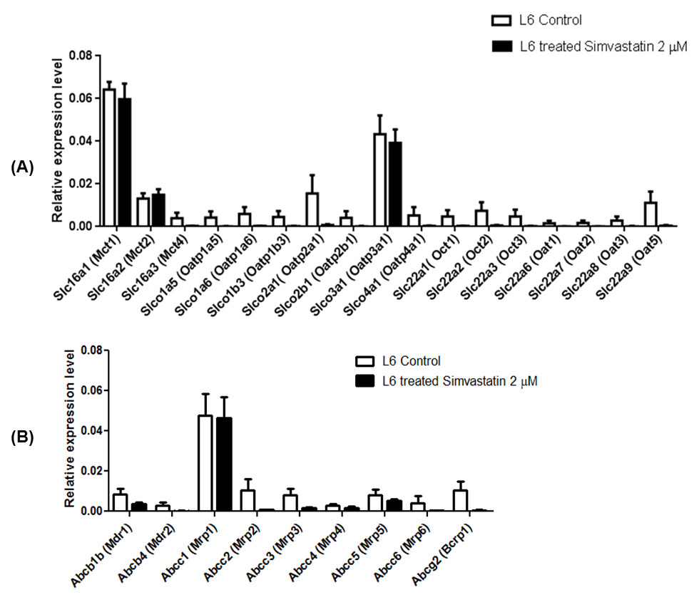
Figure 1
A selection of key (A) uptake and (B) efflux transporters in cDNA of L6 myotubes analysed by drug transporters qPCR array. The L6 myotubes were differentiated for 7 days and treated with simvastatin (2 μM) for 48 hours prior to RNA extraction. The corresponding culture with vehicle solvent (MeOH, 0.02 % v/v) represented the control. The relative expression level was analysed by standard qPCR Array and data analysis from SABiosciences website (http://www.sabiosciences.com/pcrarraydataanalysis.php). The expression levels were calculated using the 2^{−ΔΔCp} method and are relative to the geometric mean of five housekeeping genes provided by the array. Error bars represent the mean ± SEM (n=3). Mct, monocarboxylate transporter; Oatp, organic anion-transporting polypeptide; Oct, organic cation transporter; Oat, organic anion transporter; Slc, solute carrier; Slco, solute carrier organic anion family; Abc, ATP-binding cassette; Mdr1, p-glycoprotein; Mrp, multidrug resistance-associated protein; Bcrp, breast cancer resistance protein.

Slide 3
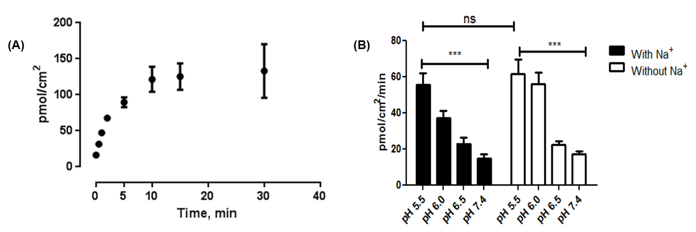
Figure 2
Time course and pH-dependency uptake of 3H-DL-Lactate in myotubes of L6 rat muscle cells. (A) The ³H-DL-Lactic acid (50 μM) uptake by L6 (at pH 6.0 and 37°C) was linear up to 5 minutes and 2 minutes incubation time was chosen for subsequent experiments. (B) Effect of pH and Na+ on the uptake of DL-lactate (50 μM) by L6 cells. Data are presented as mean ± SEM (n= 12) from three independent determinations. Na+, sodium ion.

Slide 4
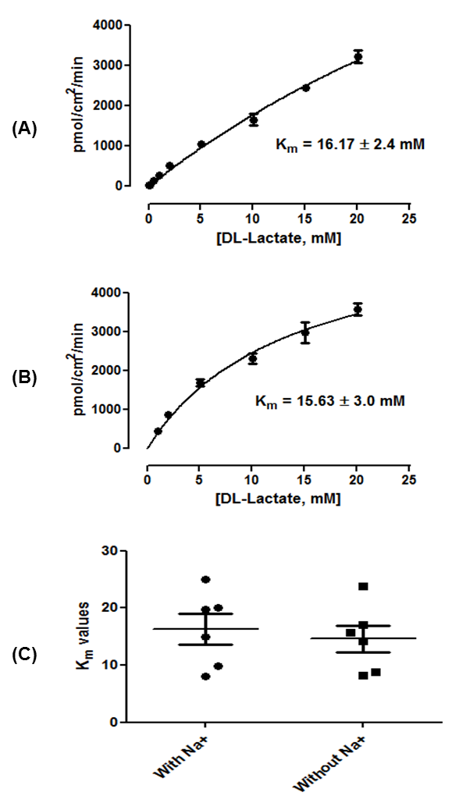
Figure 3
Concentration-dependence of DL-lactate uptake by L6 myotubes. ³H-DL-Lactate uptake at 0.1 – 20 mM final concentration (at pH 6.0 and 37 °C) was determined over 2 minutes in (A) the presence of extracellular Na⁺ and (B) the absence of extracellular Na⁺. The K_{m} values were 16.17 ± 2.4 mM (95% CI: 11.47 - 20.87) and 15.63 ± 3.0 mM (95% CI: 9.75 – 21.51) in the presence and absence of Na⁺, respectively. Data are presented as mean ± SEM from three independent determinations. (C) The mean Km value in the presence of Na⁺ (16.17 ± 2.4 mM) was not significantly different (paired t-test) compared to that without Na⁺ (15.63 ± 3.0 mM). Data are presented as mean ± SEM (n = 6) from six parallel determinations. Na⁺, sodium ion.

Slide 5
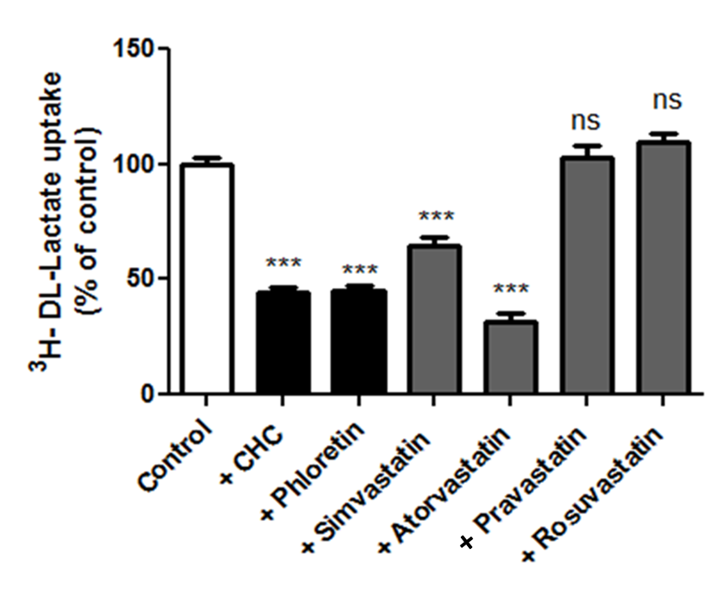
Figure 4
The DL-lactate uptake (50 μM) in the presence of statins, CHC and phloretin (all at 1 mM). Data are mean ±S.E.M. n = 12, each data point was derived from a triplicate of experiments and from four independent determinations. Data were analysed using One-Way ANOVA with Dunnett’s post-test and compared to that of control without the presence of inhibitor. CHC, α-Cyano-4 hydroxycinnamic acid N-ethyl-N,N-diisopropylammonium salt; *** p< 0.00; ns, non-significant.

Slide 6
Table 1 IC₅₀ and V_{max} values for the ability of the agents to inhibit ³H-DL-Lactate (50 µM) uptake into L6 myotubes.
Inhibitors | IC₅₀ values (95% CI) | V_{max} (mean ± SEM)
Phloretin | 8.8 ± 0.7 µM (7.43 – 10.17) | 72.07 ± 0.9 %
Simvastatin | 10.7 ± 1.2 µM (8.35 – 13.05) | 61.30 ± 1.1 %
Atorvastatin | 7.4 ± 0.9 µM (5.64 – 9.16) | 69.60 ± 0.8 %

Slide 7
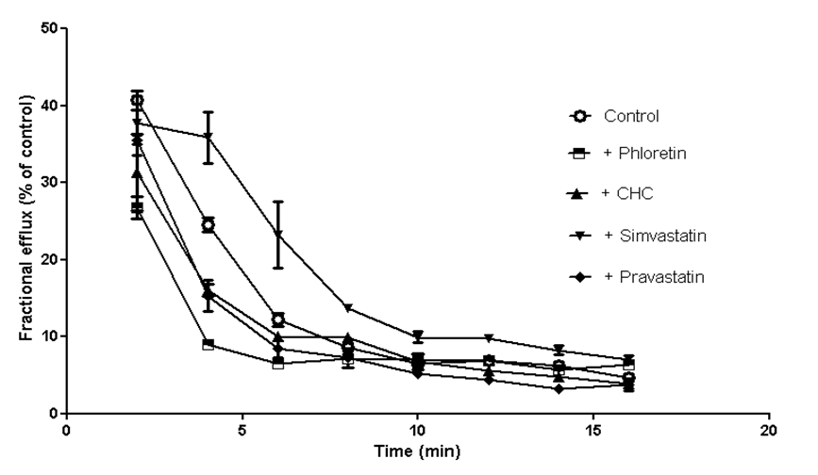
Figure 5
Efflux assay for determination of MCT1-mediated 3H-DL-Lactate (50 μM) efflux in L6 cells. There was no significant inhibition of DL-lactate (50 μM) efflux. Efflux rates were approximately 10 % for all conditions. All inhibitors were at 500 μM and each point represented as mean ±SEM (n =9) from three independent experiments. MCT, monocarboxylate transporter; CHC, α-Cyano-4 hydroxycinnamic acid N-ethyl-N,N-diisopropylammonium salt.

Slide 8
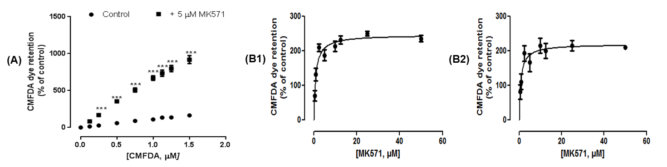
Figure 6
Inhibition of MRP-mediated CMFDA efflux by MK571 in L6 cells. (A) Addition of MK571 at 5μM resulted in a significant increase in CMFDA dye retention compared to that of control wells with K_{m} value of 6.66 ± 3.6 μM. ***P<0.0001 demonstrates the level of significance compared to the control without MK571 pre-treatment (paired T-test). (B) Dose-response curve for MRP-mediated CMFDA (1 μM) efflux inhibition by MK571 in L6 cells. L6 myotubes were exposed with simvastatin (B1) and without simvastatin (B1) pre-treatment for 48 hrs. Dye retention was measured after treatment with a range of MK571 concentrations after 40 minutes. Each point represents mean + SEM (n = 18) from 3 independent experiments.

Slide 9
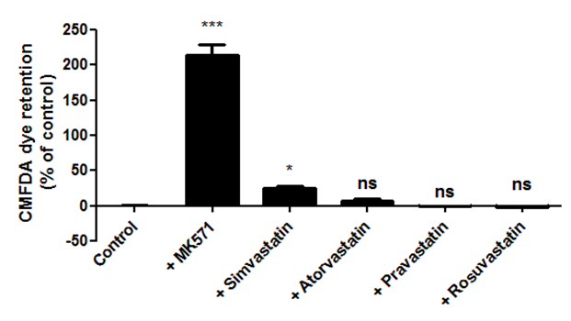
Figure 7
The inhibition by statins of the MRP-mediated CMFDA dye efflux in L6 cells. The concentration of all inhibitors used were 10 μM. Data are presented as mean ± SD (n=18) from 3 independent experiments. Data were analyzed using one-way ANOVA and Dunnett’s post-hoc test; . ***P<0.0001, *P<0.05 and ns (non-significant) versus control.

